Slide 1



Análisis SML Toxicología MG Dennise
View in Power BI
Last data refresh:
21/06/2023 23:30:02 UTC
Downloaded at:
22/06/2023 0:52:14 UTC

Slide 2
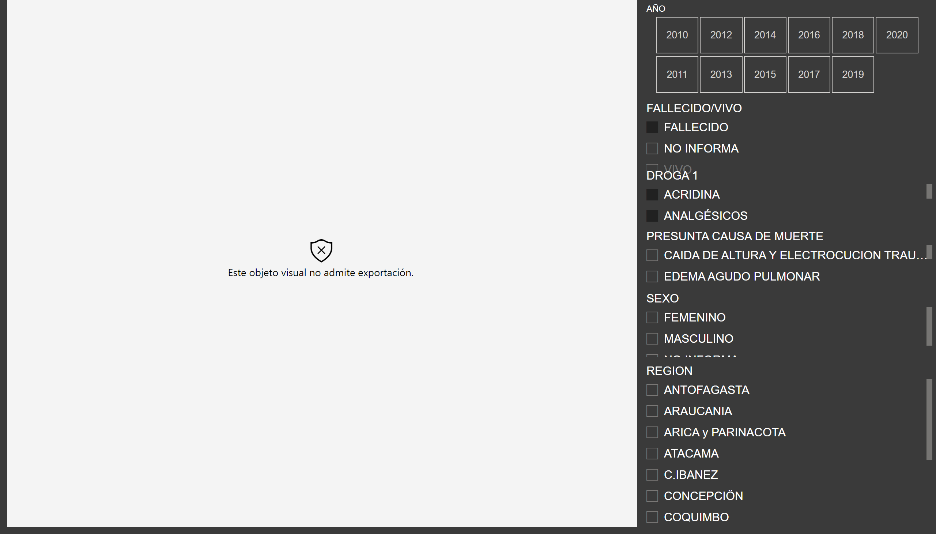
D1
Notes:
wishyoulizationbarchartrace
No alt text provided
slicer
No alt text provided
slicer
No alt text provided
slicer
No alt text provided
slicer
No alt text provided
slicer
No alt text provided
slicer
No alt text provided

